Slide 1

Rehan Theiveehathasan, Edwin Do, Timothy Chen, Brian Kibazohi, Ridhwan Chowdhury
2XB3 – L02- Group 13

Slide 2



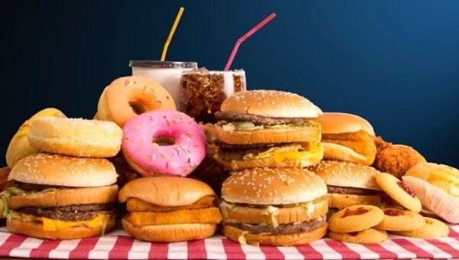
Motivation & Objective
Reduce the inconvenience factor from coming up with grocery list
Auto-generate grocery list
Budget -friendly
Make healthy eating more accessible
Vegetarian friendly
Quick and easy to use

Slide 3

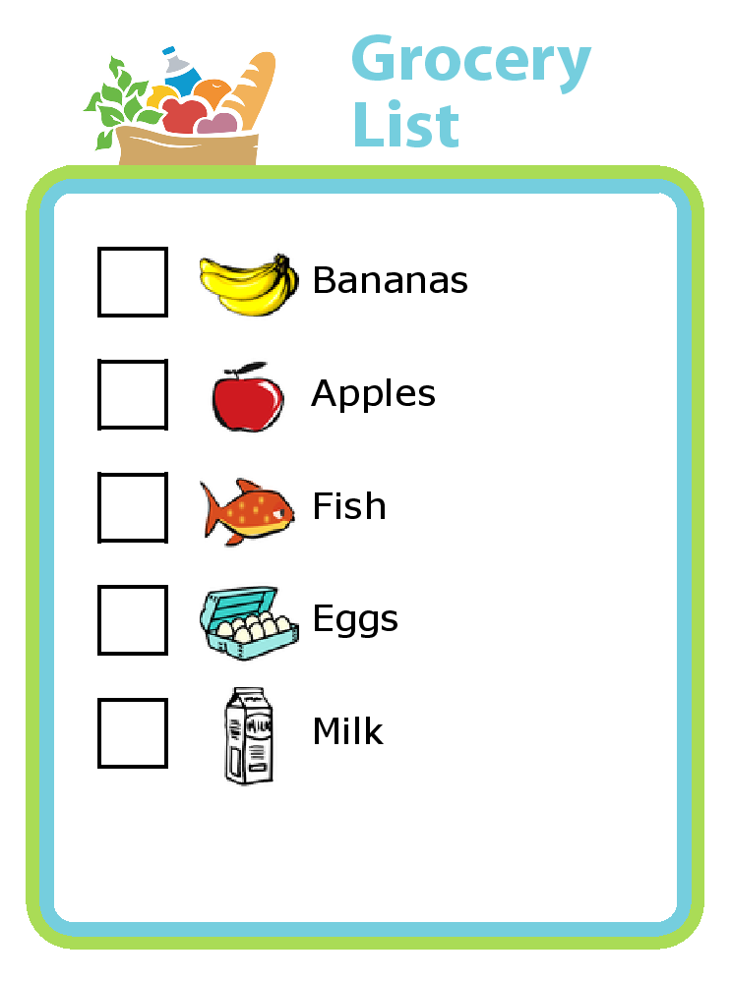
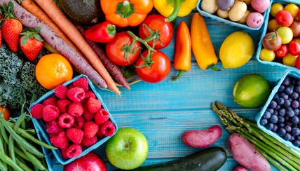
Scope
Who will it benefit?
People who are vegetarian
People who want to start trying a vegetarian diet
Anyone who is too lazy to think of grocery items
How many people can use it?
Anyone who lives in Canada and has access to a wholesale store
Prices may vary slightly but can provide a good estimation

Slide 4
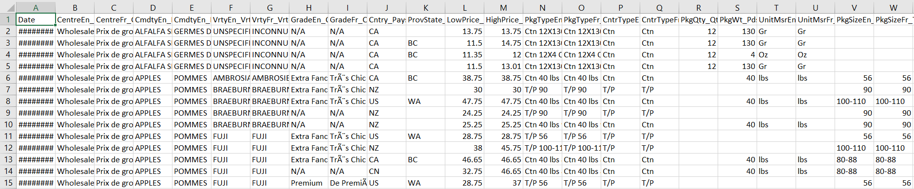
Open Dataset
Why this dataset?
How reliable/ recent is the data?
Provide a high and low price range for each individual food item
Provides the unit price allowing us to ensure the user buys a reasonable amount
The data is updated weekly

Slide 5


Main Requirements
Functional
Non-functional
Downloads an updated dataset of wholesale foods
Returns information about that store with a wholesale grocery list in interface
The interface delivers a text file with details of that grocery list (unit price, and etc.)
The team expects the program to continuously run 24/7 or for the life of the user’s machine
Privacy of the data remains concrete, user’s input data will remain on his/her own machine
Accurate results are expected based on the discrete databases

Slide 6


Main Design Specifications
Input
Algorithmic Challenges
Updated dataset of wholesale foods
User’s budget ($)
Output
Finding the longest path which is pretty difficult to implement
Creating our directed acyclic graph from our database and then sorting/linearizing
List of grocery items with unit price ($)
Text file of a possible grocery list

Slide 7


Verification and Validation
How did we test it?
We tested out product by using various datasets from different wholesale grocery stores
Ensures correctness and robustness of our program
Does it return what we want?
We want our program to return a grocery list of wholesale foods that offer the most variety
Validity is determined by checking if the list is made from the longest path of our graph

Slide 8
Demo

